Slide 1
Dual Enrollment Informational Meeting 2021
Carrye Holland, Principal
Michael Ayers, Vice Principal
Tamala Brown-Malone, Dual Enrollment Coordinator

Slide 2
Welcome to the Dual Enrollment Information Meeting
2

Slide 3
Dual Enrollment
The Dual Enrollment program gives high school students a jump start on a college education by allowing students to take college courses while still enrolled in high school. Students are enrolled at the postsecondary institution and earn postsecondary credit upon completion of the course. High school credit is awarded based on local policy.
Dual Enrollment (DE) is a postsecondary course, taught either at the postsecondary institution, at the high school, or online by postsecondary faculty or credentialed adjunct faculty.

Slide 4
Dual Credit
Statewide dual credit classes are college-level courses taught at the high-school level by trained high-school teachers.
All students enrolled in a statewide dual credit course take the online challenge exam, which is used to assess mastery of the postsecondary-level learning objectives.
Students which meet or exceed the exam ‘cut score’ receive college credit that can be applied to any Tennessee public postsecondary institution.

Slide 5
Dual Courses
Dual Enrollment and Dual Credit courses are usually open to a wide range of students. It is not only geared to high achievers; some programs actually target students who need extra motivation.
However, admission requirements vary per college, per course. Also, the prerequisites for the course must be fulfilled, ACT score, GPA ect…

Slide 6
Benefits of Dual Enrollment Courses
An opportunity to begin their freshman year of college with college credits while they also earn credits toward high school graduation
A chance to complete their bachelor’s degree faster
First-hand exposure to college-level work while still in high school, as a result
A smoother transition between high school and college
Full access to college, library, online research resources, and the IT Help Desk
Stand out when applying to colleges.
6

Slide 7
White Station’s Professors
Mrs. Cui
Mr. Garth
Mr. Herrera
Mrs. Kannady
Dr. King
Dr. Madu
Mr. Tingley
Mr. Waller
7

Slide 8
Dual Enrollment Course at
White Station
Academic Success
Anatomy I
Anatomy II
Biology I
Biology II
Calculus III
Engineering I
Engineering II
Medical Terminology
Sociology
State -Wide Dual
Pre-Calculus
Speech and Communication
Statistics
World History
America History
8

Slide 9
DE Sociology
Taught by Rachel Kannady
Online course through University of Memphis. No course pre-requisites. Must meet U of M DE admissions requirements. Qualifies for the TSAC Grant.
Sociology is the study of societies and human interactions. This course is taught using the same material as 1010 Introduction to Sociology. We start at the development of sociology and go through the basic understanding of various concepts and social constructs in modern society; race, religious, family structure, gender, culture, disability and a few others.

Slide 10
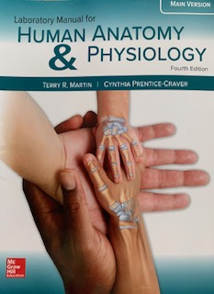
DE Anatomy & Physiology
Taught by Dr. Madu
Campus course offered through University of Memphis. No course pre-requisites. Must meet U of M DE admissions requirements. Qualifies for the TSAC Grant.
Anatomy is the sub-discipline of biology that studies the structure of the body. Anatomy provides the map and the tools for the study of the function of organs in the body. It describes the structure of the body. Physiology further describes how the body functions, while evolutionary biology provides the explanation of the structure and the function.

Slide 11
Courses on a college campus.
Students may take a course on a college campus. Those courses are usually taking after school, on the weekend, virtually or during the summer.
To accessing these courses: Visit the college course searches located on White Station’s Counselors website or those particular colleges’ dual enrollment website.
Note: When considering these courses, consult with the dual enrollment coordinator or SCS dual supervisor. Course codes and course availability have to be verified.
11

Slide 12
How to enroll in a Dual Enrollment course?
Course Selections
White Station’s Counselors Website
College’s Website
Submit Applications
Shelby County Schools
College
Tennessee Dual Grant
SAC Grant Deadlines
September 15 –Fall Semester
February 1 –Spring Semester
May 15 –Summer Semester
See more at: http://www.tn.gov/collegepays/article/dual-enrollment-grant
12

Slide 13
Dual Enrollment Mrs. Armella Smith Shelby County Schools Dual Enrollment Advisor smithaa@scsk12.org

Slide 14
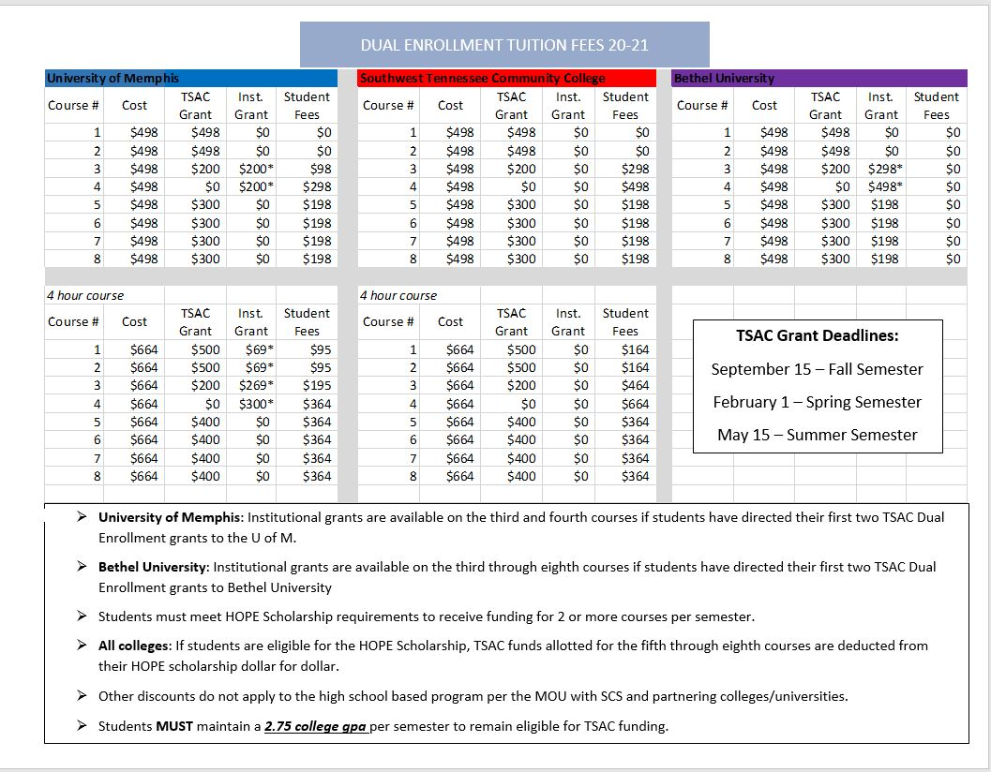
Financial Chart

Slide 15
THANK YOU
Name Mrs. Brown-Malone – White Station Counselor- Dual Enrollment
Phone: 901-416-7920
Email: browntc@scsk12.org
Website: https://whitestationsummerprograms.weebly.com/

Slide 16
Specific Questions and Answers
Instructors’ emails are linked above.

